Slide 1
Essentials of perfSONAR
Jason Zurawski – ESnet Science Engagement
engage@es.net
CC-NIE PI Workshop
April 30th 2014
With contributions from S. Balasubramanian, G. Bell, E. Dart, M. Hester, B. Johnston, A. Lake, E. Pouyoul, L. Rotman, B. Tierney and others @ ESnet

Slide 2
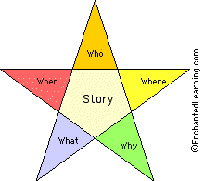
5W’s Overview
Who: Anyone who has ever suffered when using the network. Typically this will be an end user/scientist and they may not have the technical skills to fully articulate what is going on.
What: This can be ‘network’ related, but could equally be the host, application, or workflow. Blame transcends layers in the OSI model, and decoding the clues is non-trivial
Where: The $100,000 question. Unless you have instrumentation along the “path”, any/all paths stretching local to wide area, debugging is a random walk.
When: Science is a 24/7/365 enterprise, and doesn’t only encounter problems during EDT business hours. Self service is an important aspect to gather and process information.
Why: Network use is now an essential part of science – the network is an instrument similar to a particle accelerator (e.g. the tool that migrates data to analysis)

Slide 3
Agenda
Overview
(Brief) History
Use Cases & Success Stories
Suggested Deployment for Campus/Regional Use (e.g. your ‘homework’)
Conclusion

Slide 4
Overarching Motivation
Networks are an essential part of data-intensive science
Connect data sources to data analysis
Connect collaborators to each other
Enable machine-consumable interfaces to data and analysis resources (e.g. portals), automation, scale
Performance is critical
Exponential data growth
Constant human factors
Technology changes/improvements/paradigm shifts
Data movement and data analysis must keep up
Effective use of wide area (long-haul) networks by scientists has historically been difficult
Notes:
Human factors – attention span, ability to manage complexity
It is our hope that this work enables effective use of networking for science

Slide 5
The Central Role of the Network
The very structure of modern science assumes science networks exist: high performance, feature rich, global scope
What is “The Network” anyway?
“The Network” is the set of devices, applications, and processes involved in the use of a remote resource
This is not just about the network interconnection
This is about data flow from experiment to analysis, between facilities, etc.
User interfaces for “The Network” – portal, data transfer tool, workflow engine
Therefore, servers and applications must always be considered
Historically not something the campus networking team has dealt with; campus networking must evolve to remaining competitive
What is important?
Correctness
Consistency
Performance
Notes:
If networks are so important, we need to make them useful

Slide 6
Network Monitoring
All networks do some form monitoring.
Addresses needs of local staff for understanding state of the network
Would this information be useful to external users?
Can these tools function on a multi-domain basis?
Beyond passive methods, there are active tools.
E.g. often we want a ‘throughput’ number. Can we automate that idea?
Wouldn’t it be nice to get some sort of plot of performance over the course of a day? Week? Year? Multiple endpoints?
Where is the “Measurement Middleware”? Something to allow for the easy exchange of metrics that are collected locally, on a global scale?

Slide 7
Soft Failures
Soft failures are where basic connectivity functions, but high performance is not possible.
TCP was intentionally designed to hide all transmission errors from the user:
“As long as the TCPs continue to function properly and the internet system does not become completely partitioned, no transmission errors will affect the users.” (From IEN 129, RFC 716)
Some soft failures only affect high bandwidth long RTT flows.
Hard failures are easy to detect & fix
soft failures can lie hidden for years!
Soft failures can be present on the host, protocol, application, or network
One network problem can often mask others – this is common

Slide 8
Where Are The Problems?
Congested or faulty links between domains
Latency dependant problems inside domains with small RTT
Source
Campus
Backbone
Destination
Campus
S
D
NREN
Regional
Congested intra- campus links

Slide 9
Local Testing Will Not Find Everything
Performance is poor when RTT exceeds ~10 ms
Performance is good when RTT is < ~10 ms
Source
Campus
R&E
Backbone
Destination
Campus
S
D
Switch with small buffers
Regional
Regional

Slide 10
A small amount of packet loss makes a huge difference in TCP performance
Local
(LAN)
With loss, high performance beyond metro distances is essentially impossible
International
Metro Area
Regional
Continental
Measured (TCP Reno)
Measured (HTCP)
Theoretical (TCP Reno)
Measured (no loss)
10 – ESnet Science Engagement (engage@es.net) - 4/29/14
Notes:
On a 10 Gb/s LAN path the impact of low packet loss rates is minimal
On a 10 Gb/s WAN path the impact of low packet loss rates is enormous
Beyond your metro area, zero loss is essentially required for performance
Where are your collaborators? Where are your users?
When global collaboration is the norm, nobody can afford to be a local-only resource
This is why we do the engineering we do for data-intensive science

Slide 11
What is perfSONAR?
perfSONAR is a tool to:
Set network performance expectations for a variety of use cases
Find network problems (“soft failures”) & help fix these problems
Mitigate the risks that are associated with the R&E environment (e.g. get out in front of problems before its too late)
All in multi-domain environments
These problems are all harder when multiple networks are involved – need a mechanism to stop ‘finger pointing’ and get real work done
perfSONAR is provides a standard way to publish active and passive monitoring data
This data is interesting to network researchers as well as network operators
This is the measurement middleware – a way to tie together local and end-to-end measurements
A way to separate a network problem from that of an application or host
Notes:
Enables Federation
Service oriented
Designed with ‘multi-domain’ in mind
Brings together useful tools to address different needs
Several active and passive tools
Interface to configure regular testing
Diagnostic tools ready with ‘0 configuration’
Easy to install, easy to use
ISO image can be burned to CD/USB key
‘Wizard’ interface for configuration
Encouraging people to deploy ‘known good’ measurement points near domain boundaries
“known good” = hosts that are well configured, enough memory and CPU to drive the network, proper TCP tuning, clean path, etc.
Community Adoption
Over 600 instances seen world wide as of early May
20+ countries
100s of domains

Slide 12
Agenda
Overview
(Brief) History
Use Cases & Success Stories
Suggested Deployment for Campus/Regional Use (e.g. your ‘homework’)
Conclusion

Slide 13
The Ghost of perfSONAR Past
Internet2 Performance Evaluation and Review Framework (PERF) - ~2002

Slide 14
The Ghost of perfSONAR Past
GEANT2/JRA1 Framework Layers (~2004)

Slide 15
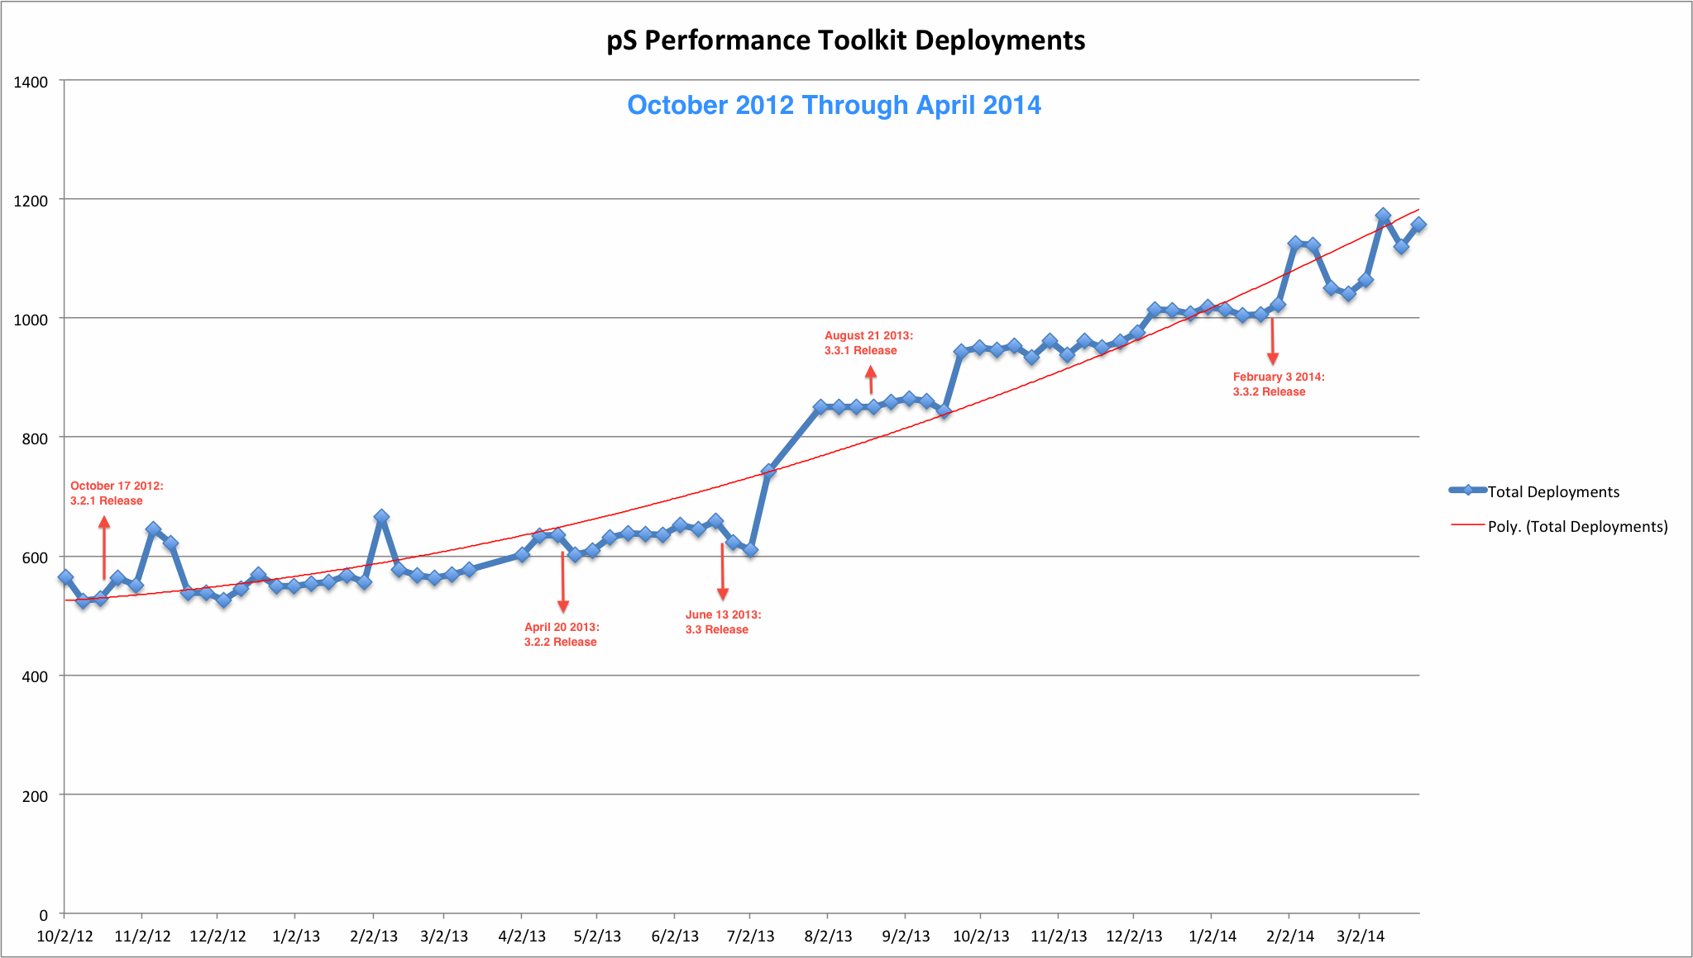
The Ghost of perfSONAR Present

Slide 16
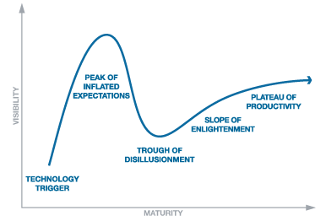
The Ghost of perfSONAR Present
?

Slide 17
Lookup Service Directory Search: http://stats.es.net/ServicesDirectory/

Slide 18
Agenda
Overview
(Brief) History
Use Cases & Success Stories
Suggested Deployment for Campus/Regional Use (e.g. your ‘homework’)
Conclusion

Slide 19
Use Cases & Success Stories
Now at 10 years old – the project is known enough to be widely deployed, and has become widely useful.
ESnet troubleshooting always starts with the same questions: We can’t find your perfSONAR instance in the directory, do you have one? If not, when can you complete installation?
30 minutes to setup and configure. Email me and I will even walk you through it (engage@es.net)
ROI for this is high – every day a scientist has a problem exercising the network is a net economic loss for the University. Spend the time and the $ for a server if you haven’t done so already.
Could this be done with something ‘perfSONAR like’ – sure, if its widely available. perfSONAR has hit critical mass and this makes it highly valuable
The following are very quick snapshots of problems, with narratives on when the data told the operators. All assume:
perfSONAR set up to regularly exercise the scientific path (e.g. an end to end test of network metrics from where the scientists are sitting, to where they are interacting with colleagues)
Staff that are willing and able to configure and interpret the data.
If you just said to yourself ‘I don’t have any of that’: http://oinworkshop.com

Slide 20
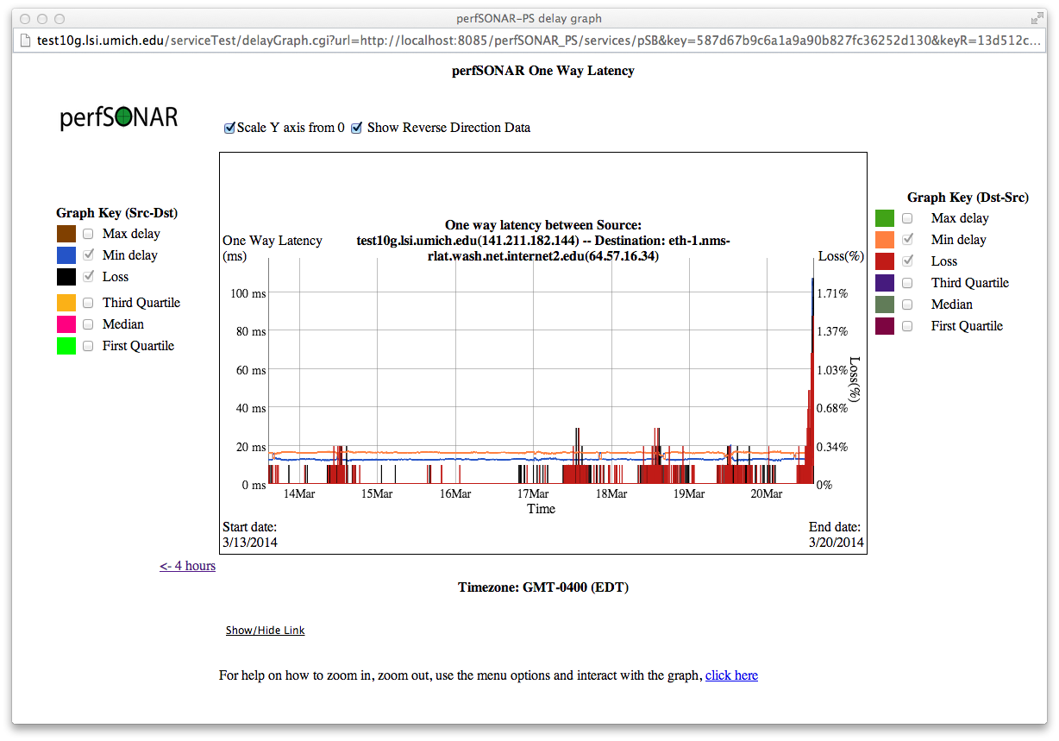
Congestion – via OWAMP Loss

Slide 21
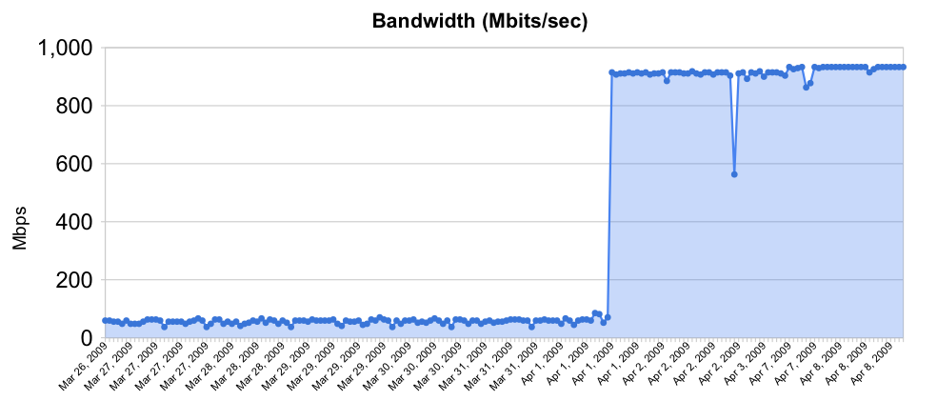
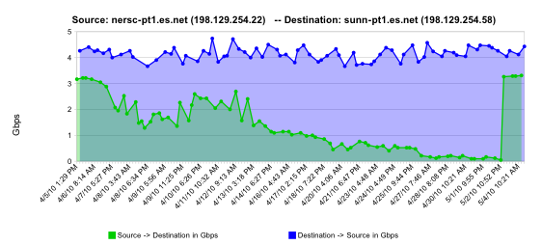
Soft Routing/Interface Failures
Rebooted router with full route table (USATLAS)
normal performance
Gradual failure of optical line card (ESnet)
Gb/s
degrading performance
repair
one month

Slide 22
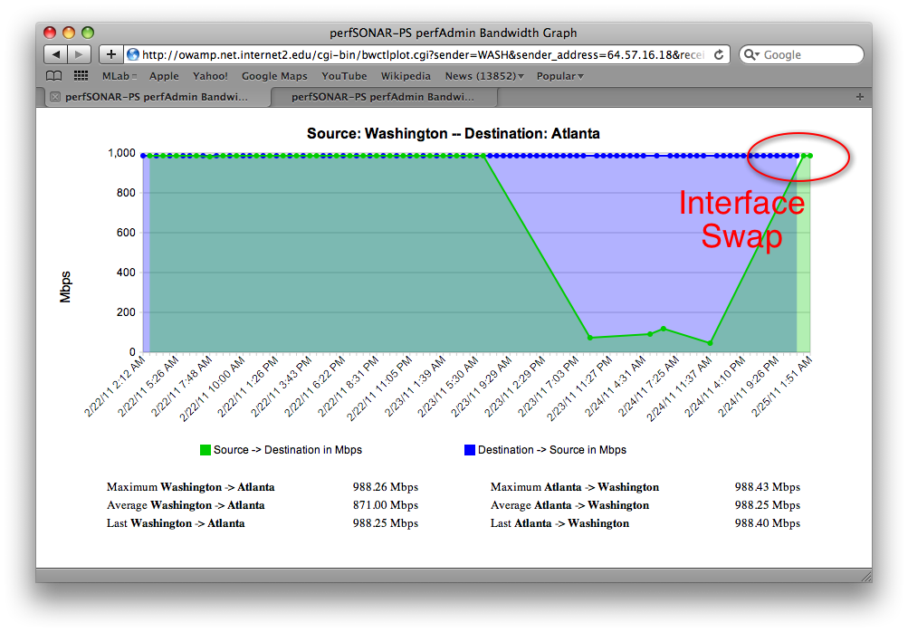
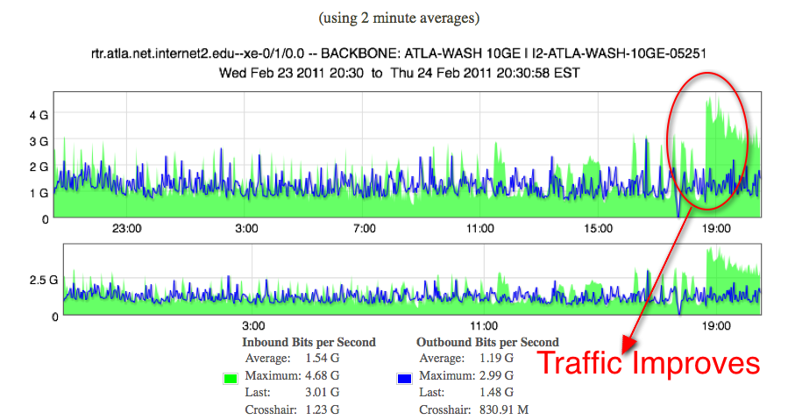
Failing Optics (BWCTL and Utilization)
Example taken from Internet2 backbone

Slide 23
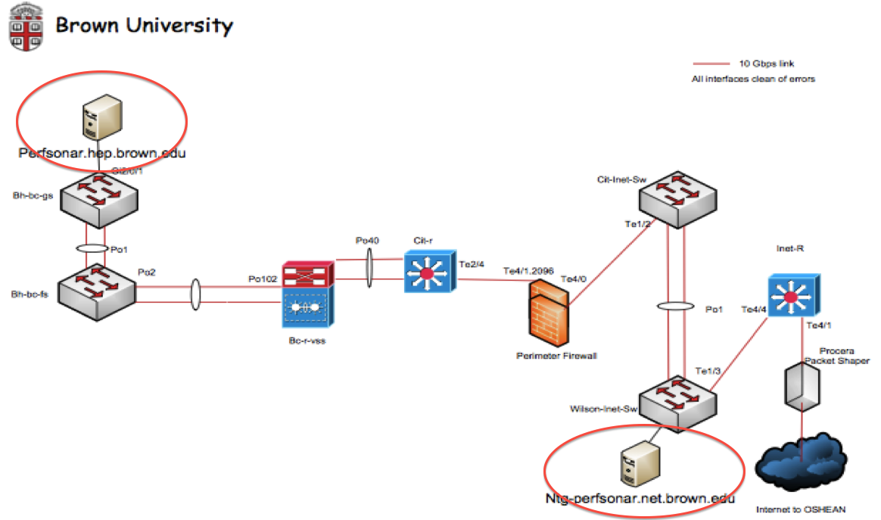
Firewalls
When used as a comparison tool – we can see that security devices are impacting performance
Powerful incentive to fix this in the scientific path

Slide 24
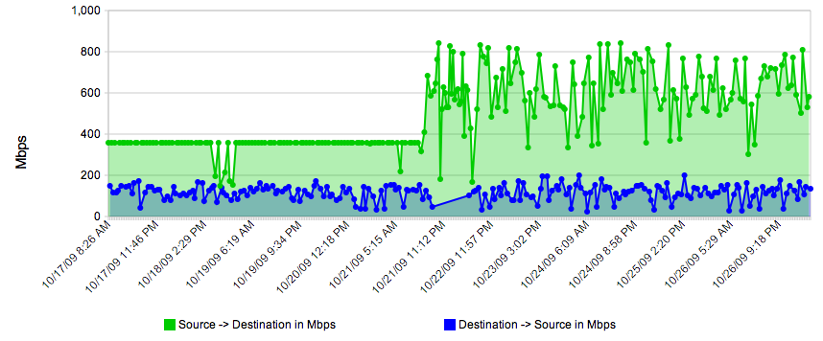
Host Tuning
Simple example – play with the settings in /etc/sysctl.conf when running some BWCTL tests.
See if you can pick out when we raised the memory for the TCP window

Slide 25
Agenda
Overview
(Brief) History
Use Cases & Success Stories
Suggested Deployment for Campus/Regional Use (e.g. your ‘homework’)
Conclusion

Slide 26
perfSONAR Toolkit
The “perfSONAR Toolkit” is an open source implementation and packaging of the perfSONAR measurement infrastructure and protocols – everything you (or your scientists) needs to get a baseline and start addressing true problems
http://psps.perfsonar.net/toolkit
All components are available as RPMs, and bundled into a CentOS 6-based “netinstall” and a “Live CD”
perfSONAR tools are much more accurate if run on a dedicated perfSONAR host, not on the DTN.
Very easy to install and configure
Usually takes less than 30 minutes

Slide 27
Importance of Regular Testing
We can’t wait for users to report problems and then fix them (soft failures can go unreported for years!)
Things just break sometimes
Failing optics
Somebody messed around in a patch panel and kinked a fiber
Hardware goes bad
Problems that get fixed have a way of coming back
System defaults come back after hardware/software upgrades
New employees may not know why the previous employee set things up a certain way and back out fixes
Important to continually collect, archive, and alert on active throughput test results

Slide 28
Regular perfSONAR Tests
We run regular tests to check for two things
TCP throughput
One way delay and packet loss
perfSONAR has mechanisms for managing regular testing between perfSONAR hosts
Statistics collection and archiving
Graphs
Dashboard display
Integrate with NAGIOS
This infrastructure is deployed now – perfSONAR hosts at facilities can take advantage of it
At-a-glance health check for data infrastructure

Slide 29
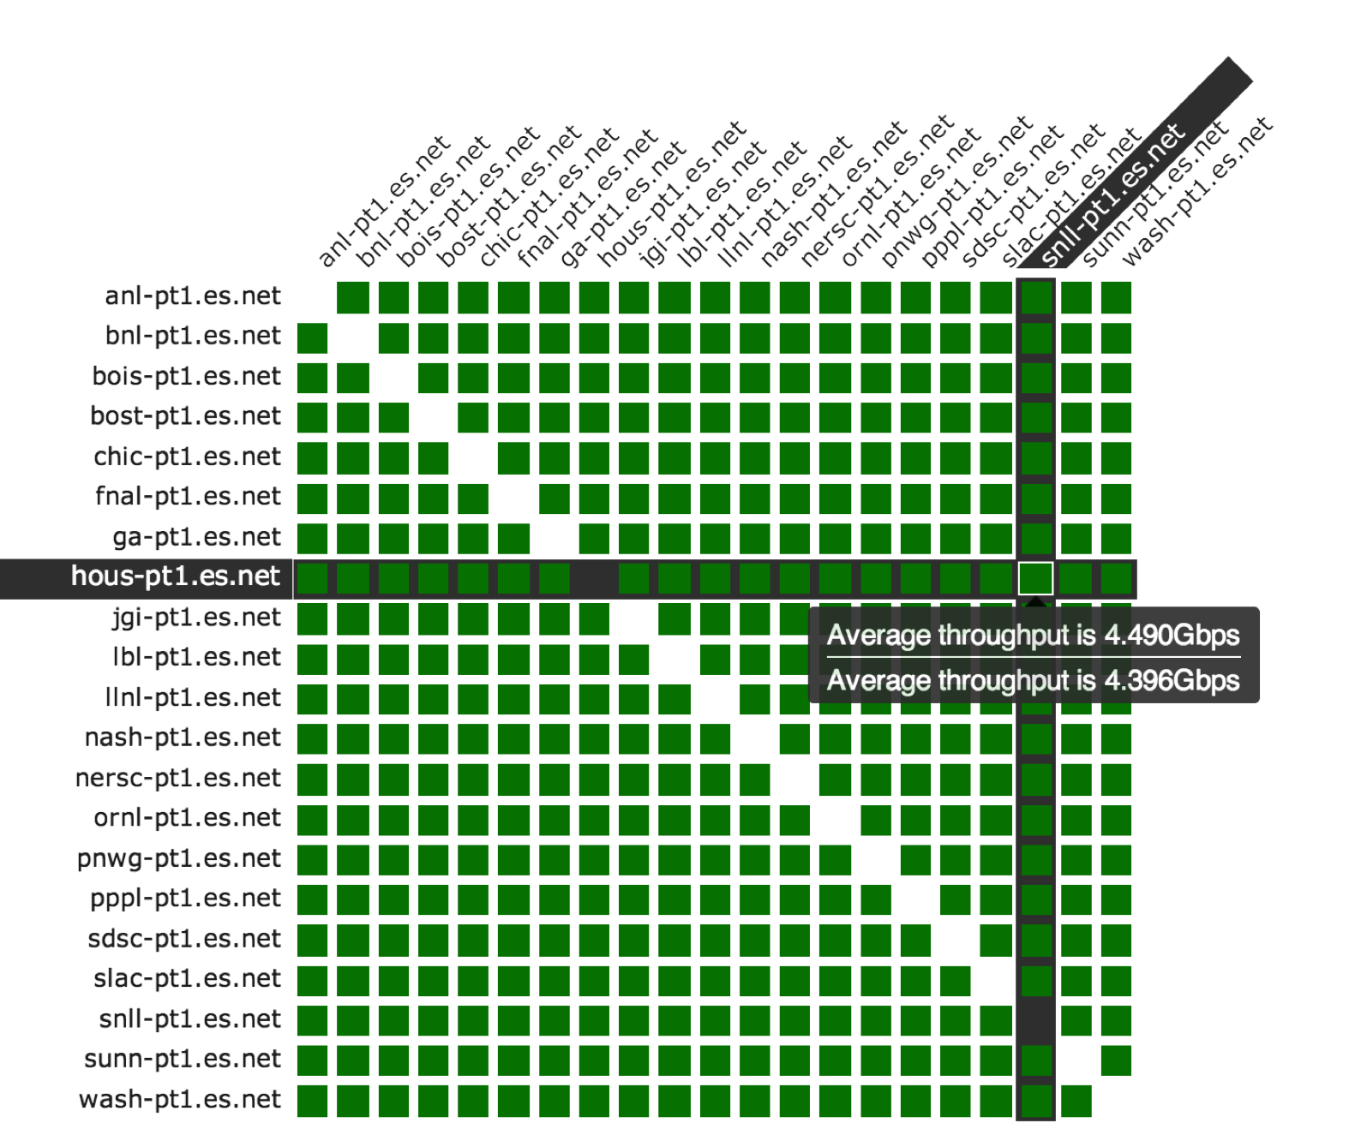
perfSONAR Dashboard: http://ps-dashboard.es.net

Slide 30
Develop a Test Plan
What are you going to measure?
Achievable bandwidth
2-3 regional destinations
4-8 important collaborators
4-8 (more if you are willing, especially to start) times per day to each destination
20-30 second tests within a region, longer across oceans and continents
Loss/Availability/Latency
OWAMP: ~10-20 collaborators over diverse paths
Interface Utilization & Errors (via SNMP)
Guidance on servers to buy:
http://psps.perfsonar.net/toolkit/hardware.html
Virtualization is tricky, recommended to go dedicated hardware.

Slide 31
perfSONAR Deployment Locations
Critical to deploy such that you can test with useful semantics
perfSONAR hosts allow parts of the path to be tested separately
Reduced visibility for devices between perfSONAR hosts
Must rely on counters or other means where perfSONAR can’t go
Effective test methodology derived from protocol behavior
TCP suffers much more from packet loss as latency increases
TCP is more likely to cause loss as latency increases
Testing should leverage this in two ways
Design tests so that they are likely to fail if there is a problem
Mimic the behavior of production traffic as much as possible
Note: don’t design your tests to succeed
The point is not to “be green” even if there are problems
The point is to find problems when they come up so that the problems are fixed quickly
Notes:
A lot of people want to prove that they are not the problem, and design their tests to succeed. This is not helpful.

Slide 32
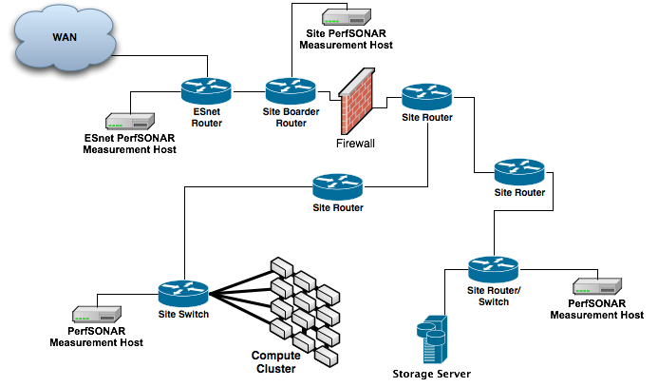
Sample Site Deployment

Slide 33
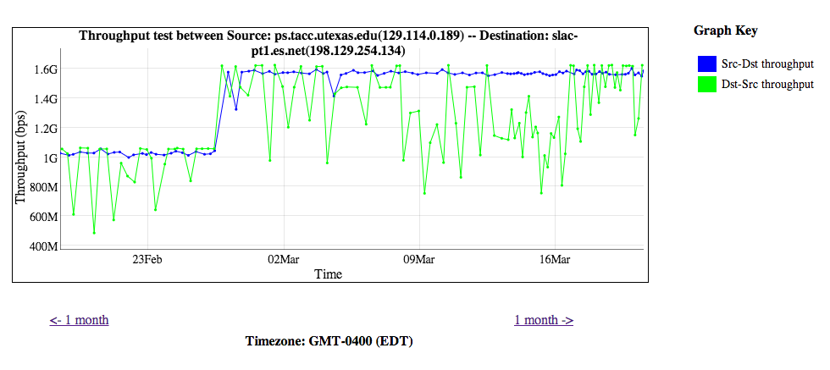
Regular Monitoring Win

Slide 34
Agenda
Overview
(Brief) History
Use Cases & Success Stories
Suggested Deployment for Campus/Regional Use (e.g. your ‘homework’)
Conclusion

Slide 35
Conclusion
Difficulty in using a network for data intensive science is an inevitability
Hosts, applications, workflow, networks
All problems have the same symptom – things don’t work as well as they should
Waiting until a problem arises before having a mitigation strategy prepared is folly
There are evacuation plans, drills, and countermeasures for fire in a building
There should be a similar set of BCPs and infrastructure for dealing with the needs of the scientific community as they use your networks
Having the tools is only the first step; training and integration is the next logical step and will take time and resources
http://oinworkshop.com
Help is out there, do not hesitate to ask
scienedmz@es.net
perfsonar-user@internet2.edu

Slide 36
Essentials of perfSONAR
Questions/Comments/Criticisms?
Jason Zurawski - zurawski@es.net
ESnet Science Engagement – engage@es.net
http://psps.perfsonar.net

